Slide 1

AirBnb Price Prediction
By: Nick Lichtsinn

Slide 2
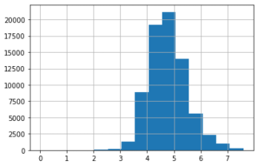
Motivation and Project Scope
Airbnb is a home-sharing platform that allows homeowners and renters to put their properties online.
This project will attempt to solve this problem by using decision tree, naïve bayes and k-means clustering models to predict the log_price for properties in 6 major cities in the United States

Slide 3
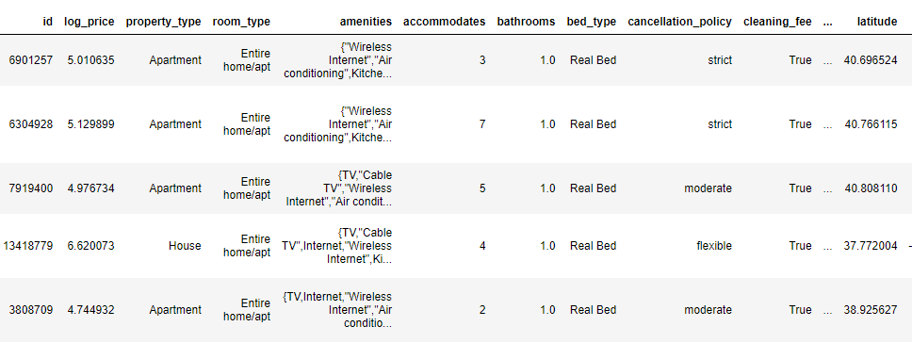
About the Data
The dataset consists of 74,111 rows and 29 columns of features for each Airbnb listing from 6 major US cities (Boston, Chicago, DC, LA, NYC, SF).
Some of the features include number of bedrooms, type of property, amenities, cancellation policy, reviews and host information.

Slide 4
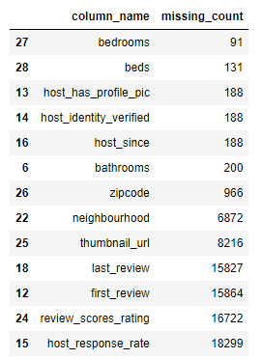
Pre-processing
Dropped unused features and features that would be difficult to enumerate. Mostly review dates and location information other than city.
Filled na’s with default 0 (beds, bedrooms, bathrooms) and enumerated Boolean options (T/F).
Used Label Encoding to enumerate categorical features (neighborhood, room type, property type, city, etc.)

Slide 5
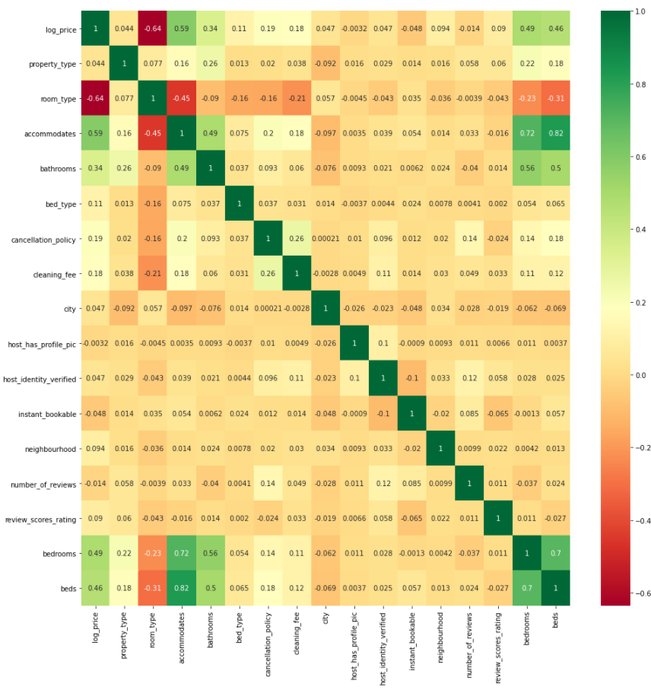
Correlation
There is a strong relationship between log_price and room type, accommodates, bedrooms and beds.

Slide 6
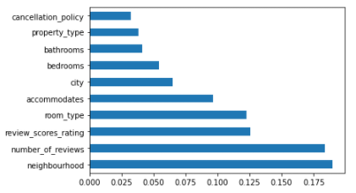
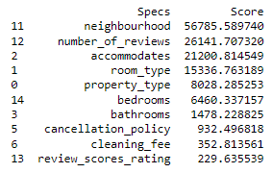
Feature importance
Top 10 features using Tree Based Classifier
Top 10 features using Univariate Selection (SelectKBest)

Slide 7
Binning
Finding an exact price was not practical for most classification methods and a price range can still be very useful, so log_price was discretized into four categories (low, medium, high, very high).
Both equal frequency and equal width binning methods were used and results shown.

Slide 8
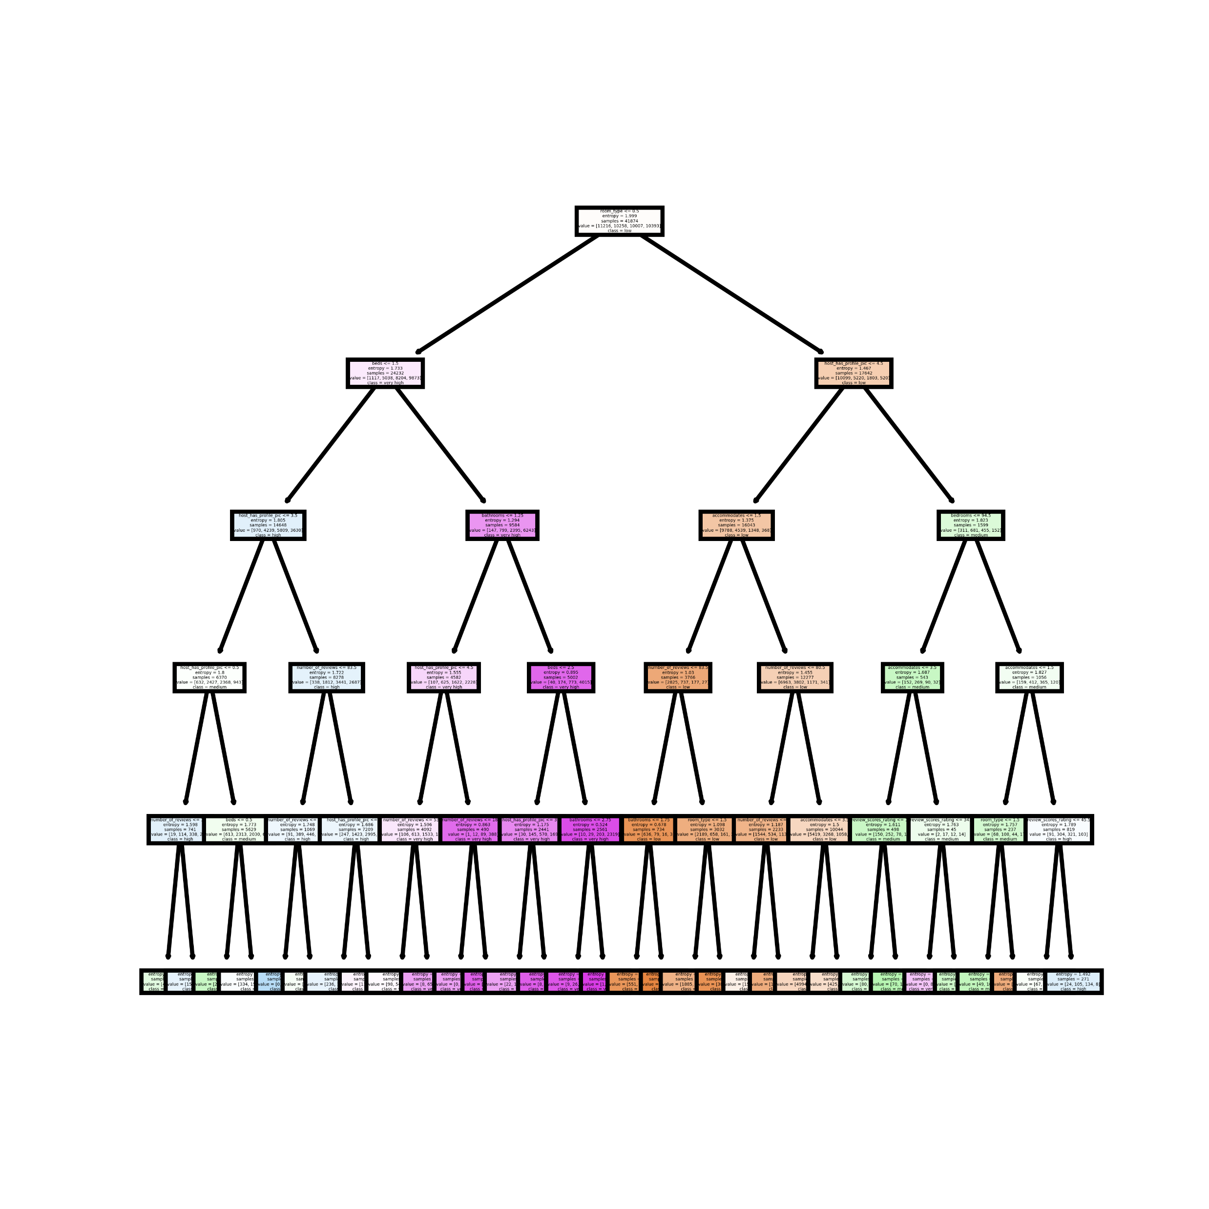
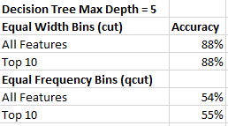
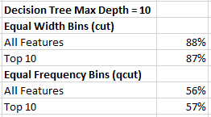
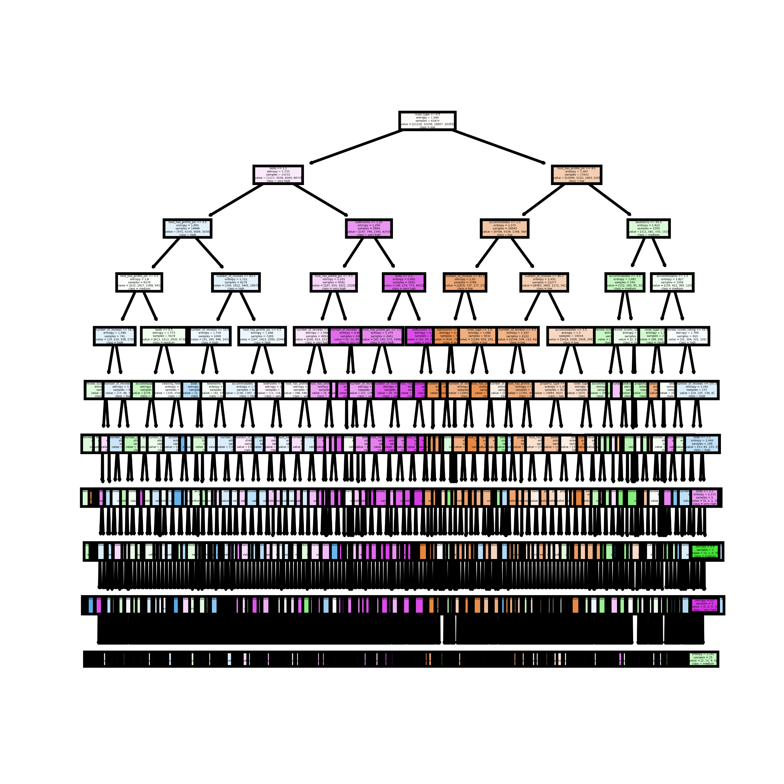
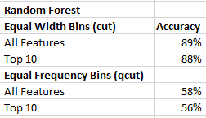
Decision Tree Models
Max Depth = 5
Max Depth = 10

Slide 9
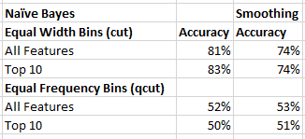
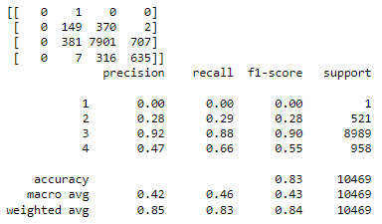
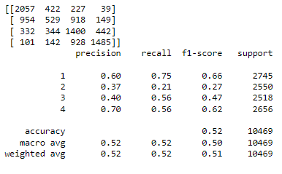
Naïve Bayes Models
Used Gaussian Naïve Bayes Model
Tuned with var_smoothing with 100 and 1000 fits to mixed results

Slide 10
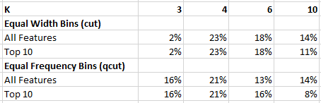
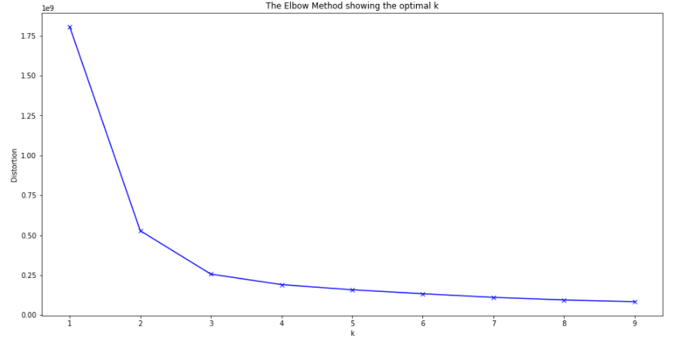
K-means Clustering models
All Features
Top 10 Features
Used Elbow plots and Standard Square Error to calculate ideal number of clusters
Tested 3, 4, 6, 10
Used max_iter and algorithm to tune model to worse results
Scaled values with Scaler with drastically reduced accuracy (9.55e^-05)

